Slide 1


IDEATHON - 2026
Robotic Mobile Fulfillment Systems
Himani K H (22PW19)
Induja S (22PW20)
L S Roshini (22PW23)
Next Slide

Slide 2
01
Introduction to Robotic Mobile Fulfillment Systems
02
Implementation of the Proposed System
03
Results and Evaluation
04
Discussion on Methodology and Limitations
05
Conclusion and Future Work
06
References

Slide 3
Introduction to Robotic Mobile Fulfillment Systems
Abstract
This paper presents an integrated approach to optimizing order allocation and shelf selection in Robotic Mobile Fulfillment Systems (RMFS) using Genetic Algorithms, Ant Colony Optimization, and Reinforcement Learning.
The methodology involves optimizing order assignments to robots, determining efficient shelf-picking routes, and training reinforcement learning models for improved robot movement.

Slide 4
Introduction
AI-Driven Optimization Techniques
Definition of RMFS
Robotic Mobile Fulfillment Systems revolutionize warehouse operations by enabling autonomous robots to pick and transport orders.
Employed techniques include Genetic Algorithms for order allocation, Ant Colony Optimization for shelf routes, and Reinforcement Learning for adaptive robot navigation.
Challenges in RMFS
Challenges include optimizing order allocation to robots and determining efficient paths due to dynamic order demand and warehouse constraints.

Slide 5
Implementation of the Proposed System
Data Loading
Path Optimization with Ant Colony Optimization
The system reads datasets: orders.csv, shelves.csv, and robots.csv and computes the distance matrix for efficient processing.
Optimizes shelf-picking routes via pheromone-based exploration, updating pheromone levels to guide robots effectively.
Order Allocation Using Genetic Algorithm
Orders are allocated to robots based on workload balance, minimizing travel distances through an iterative process.

Slide 6
Environment Setup
State and Action Representation
Reinforcement Learning for Navigation
Defines a custom Gym environment simulating warehouse space; robots learn movement strategies using Proximal Policy Optimization.
The robot's current position defines state; movement between shelves serves as possible actions, with a reward function based on distance.
Training and Efficiency
Robots undergo training for 10,000 timesteps to refine navigation skills and reduce travel distance.

Slide 7

Performance Metrics
Impact of Reinforcement Learning
Order Allocation Analysis
Shelf Selection Improvement
GA shows improved workload distribution among robots with lower variance in maximum and minimum orders processed.
ACO resulted in a significant reduction of 30% in total travel distance compared to random selection.
PPO training led to reduced average distance per order and faster completion times.

Slide 8
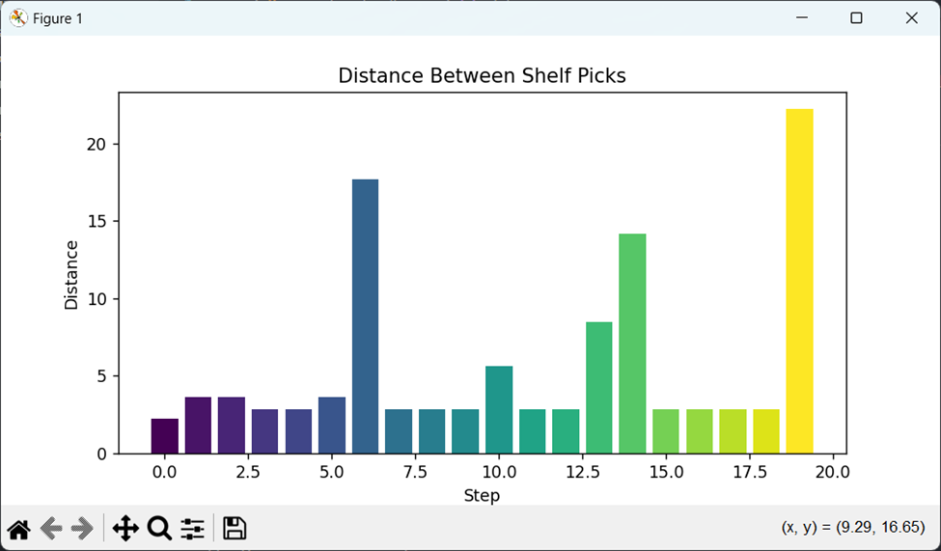
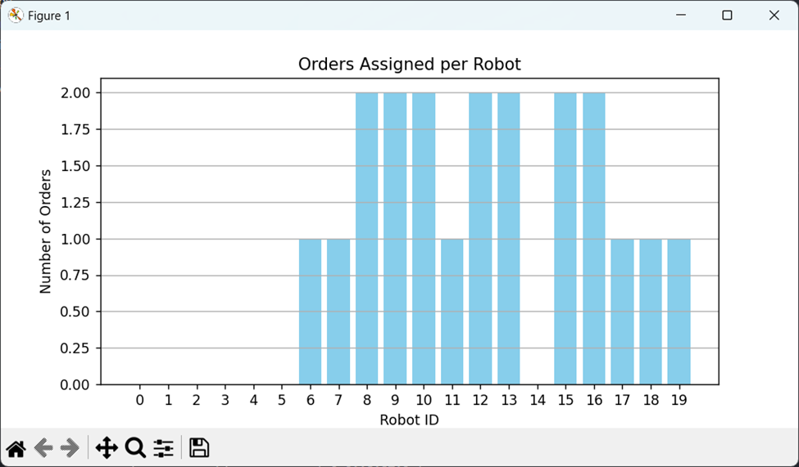
Results and
Evaluation

Slide 9
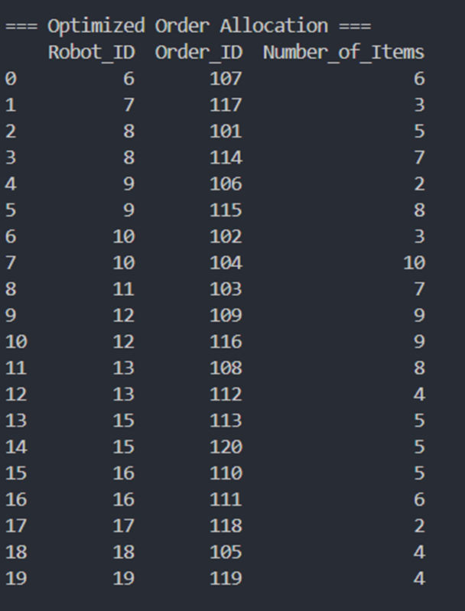

Slide 10


Discussion on Methodology and Limitations
Rule-Based Order Allocation Challenges
Fixed heuristics hinder load distribution; GA optimizes allocation by factoring workload and distance.
Nearest Neighbor Shelf Selection Issues
Common greedy algorithms often miss optimal paths; ACO enables better global optimization through adaptive routing.
Predefined Path Planning Drawbacks
Traditional algorithms struggle with dynamic changes; RL enhances adaptability for real-time adjustments.

Slide 11



Advantages of
Hybrid Approach
GLOBAL OPTIMIZATION
The hybrid model optimizes all fulfillment stages collectively for superior performance.
Adaptability to Changes
Reinforcement learning allows robots to adjust movements based on real-time conditions, enhancing efficiency.
GAINS IN EFFICIENCY
Reduction of unnecessary movements and balanced workloads leads to significant time-saving and throughput improvements.

Slide 12


References
Key Research Paper
Optimizing Robotic Mobile Fulfillment Systems for Order Picking Based on Deep Reinforcement Learning&quot; by Zhenyi Zhu, Sai Wang, and Tuantuan Wang.
Research Paper Link

Slide 13
Thank
You!

